Slide 2
Pathology of premalignant lesions
Dr. Mohammad Parniani MD – AP/AC

Slide 3
INtroduction
Lesion that is not itself malignant, but has greater probability of becoming so than normal tissue.

Slide 4
Chronic persistent stimulus
Chronic irritation
Hormones
Tissue damage
Proliferation
Hyperplasia/Metaplasia
Dysplasia
Regeneration
Ca. In Situ
Invasive Carcinoma

Slide 5
Female Breast
Epithelial proliferative changes : risk of Ca.
Mild (3-4 epithelial cells layers)
Moderate to Florid (>4 layers)
Atypical (ADH & ALH)

Slide 6
Categories on basis of risk of invasive ca.
Categories
Type of Hyperplasia
Risk
I
No / Mild hyperplasia
No risk
II
Moderate / florid
1.5-2 times
III
ADH / ALH
5 times
IV
CIS
8-10 times

Slide 7
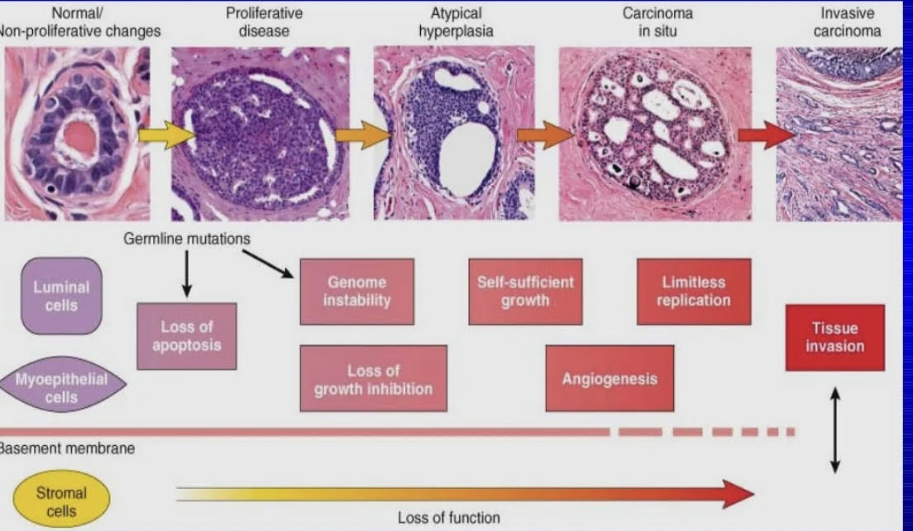

Slide 8
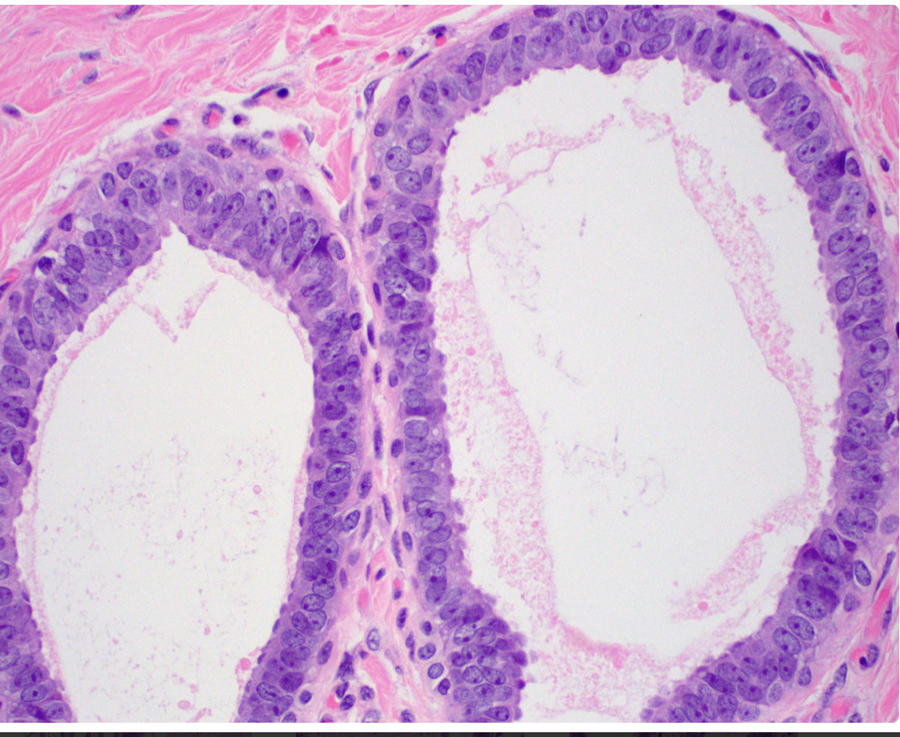
Ductal intraepithelial neoplasia (DIN)
DIN 1a : Flat epithelial atypia

Slide 9
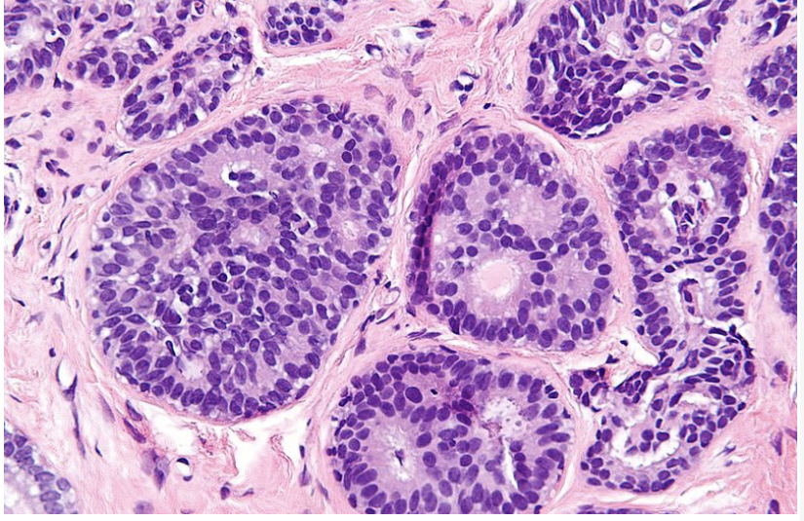
DIN 1b: Atypical ductal hyperplasia ( < 2mm)

Slide 11
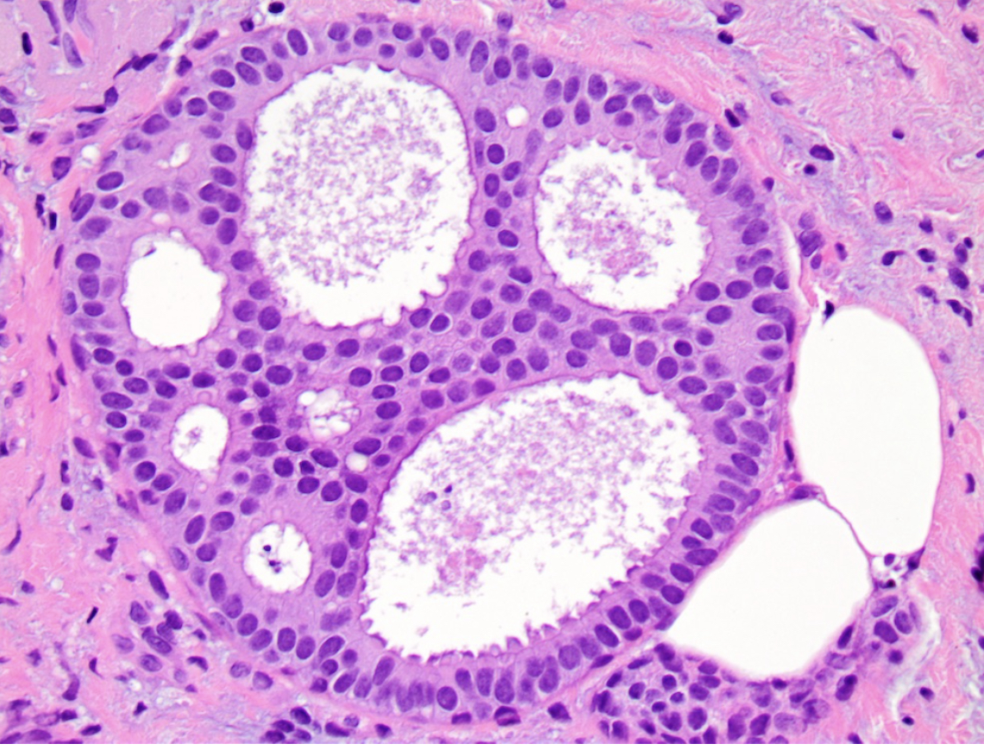
DIN 1c : Low grade DCIS ( > 2 mm)

Slide 13
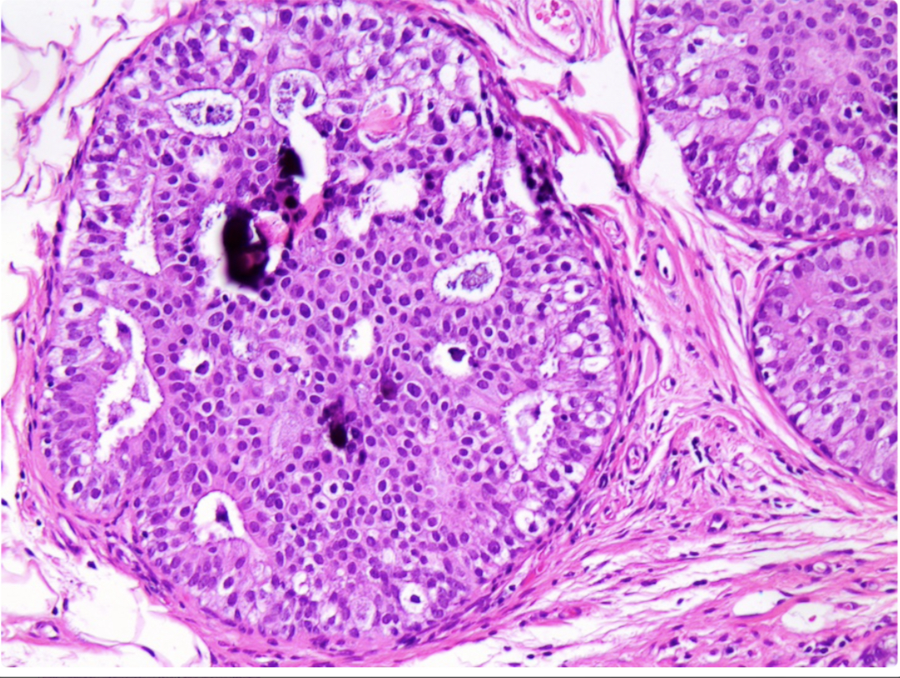
DIN 2 : Intermediate grade DCIS

Slide 14
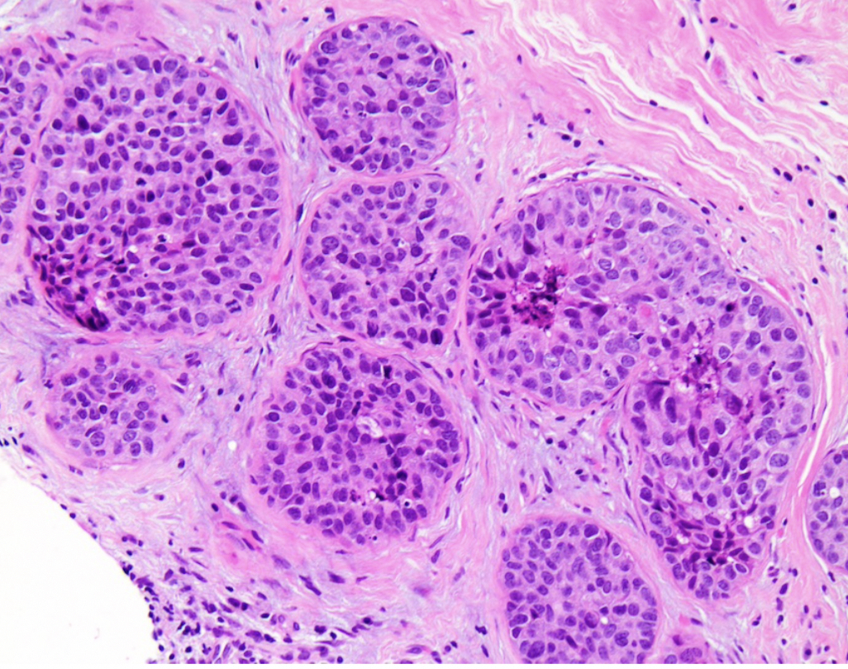
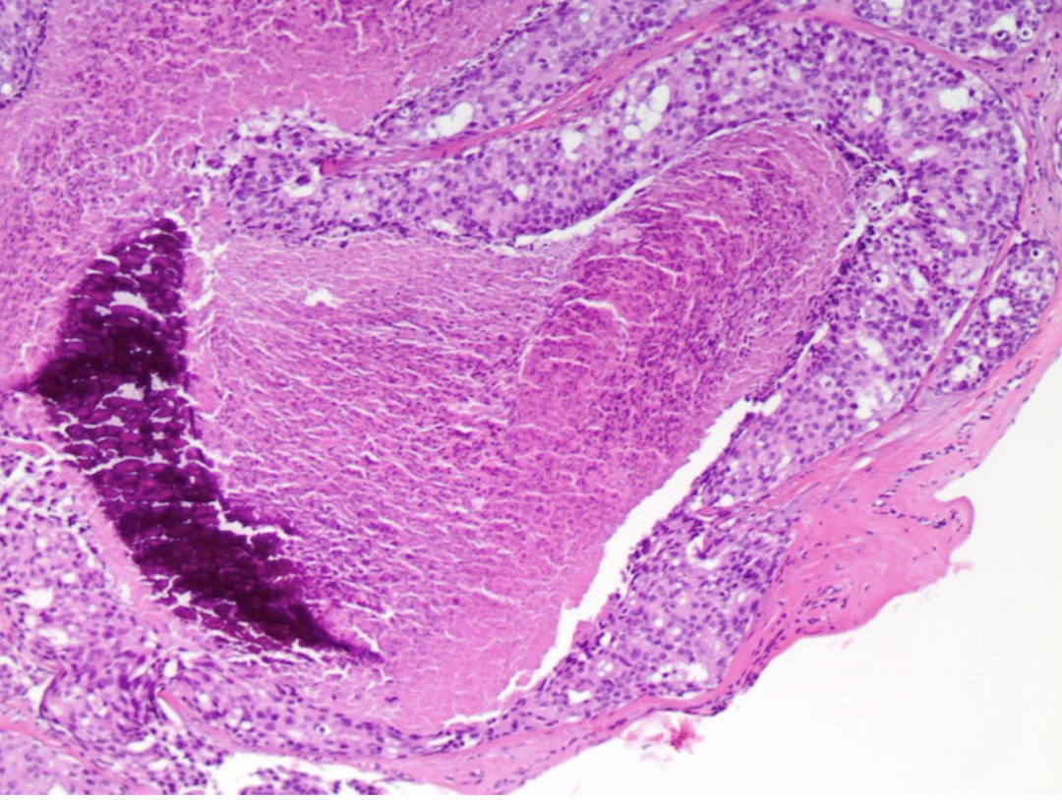
DIN 3: High grade DCIS

Slide 17
IHC
CK 5,6
HMWK
CK-14
P63
SMMH
SMA
ER

Slide 18
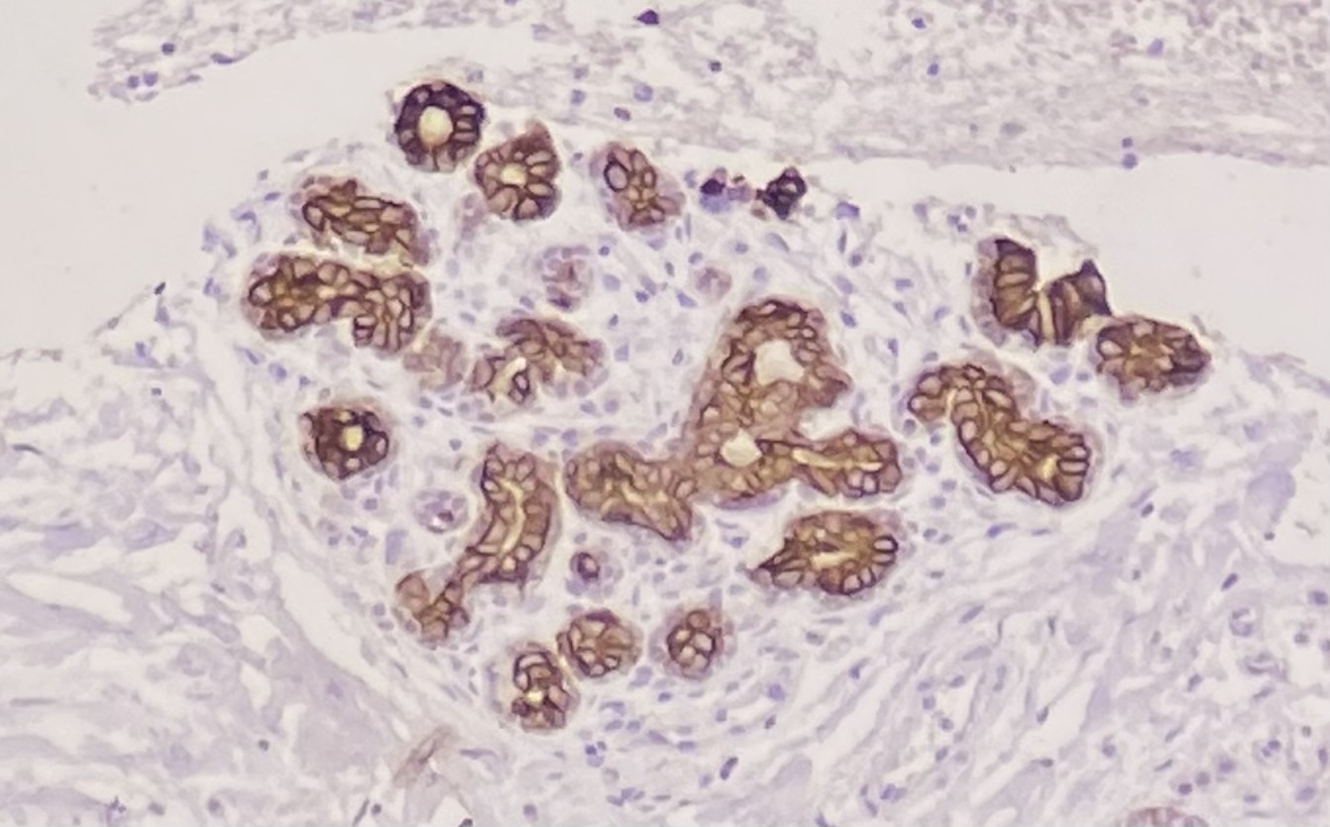
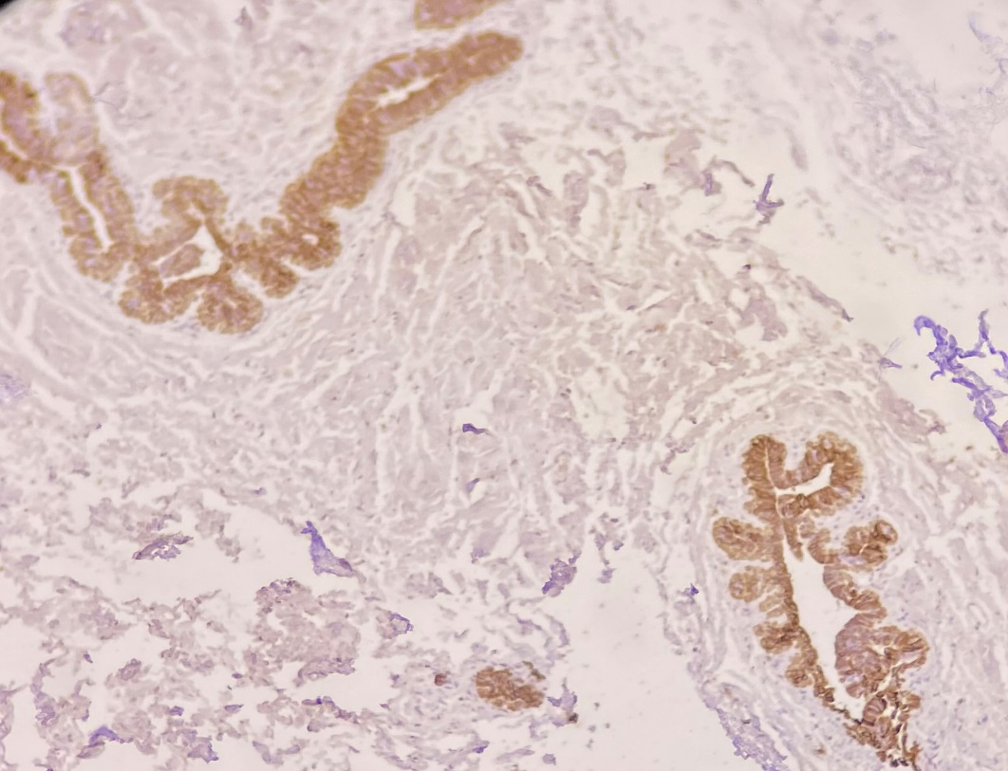
CK 5,6 / HMWK positive
CK 5,6
HMWK

Slide 19
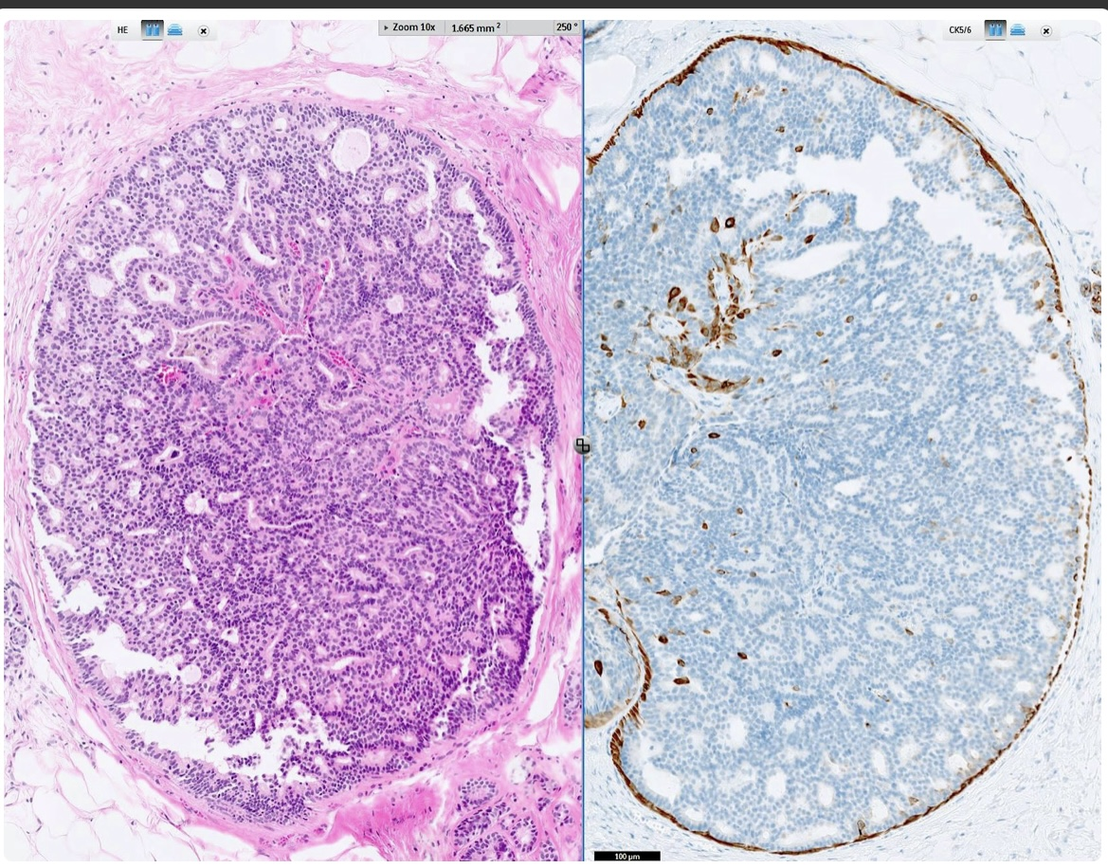
CK 5,6 negative

Slide 20
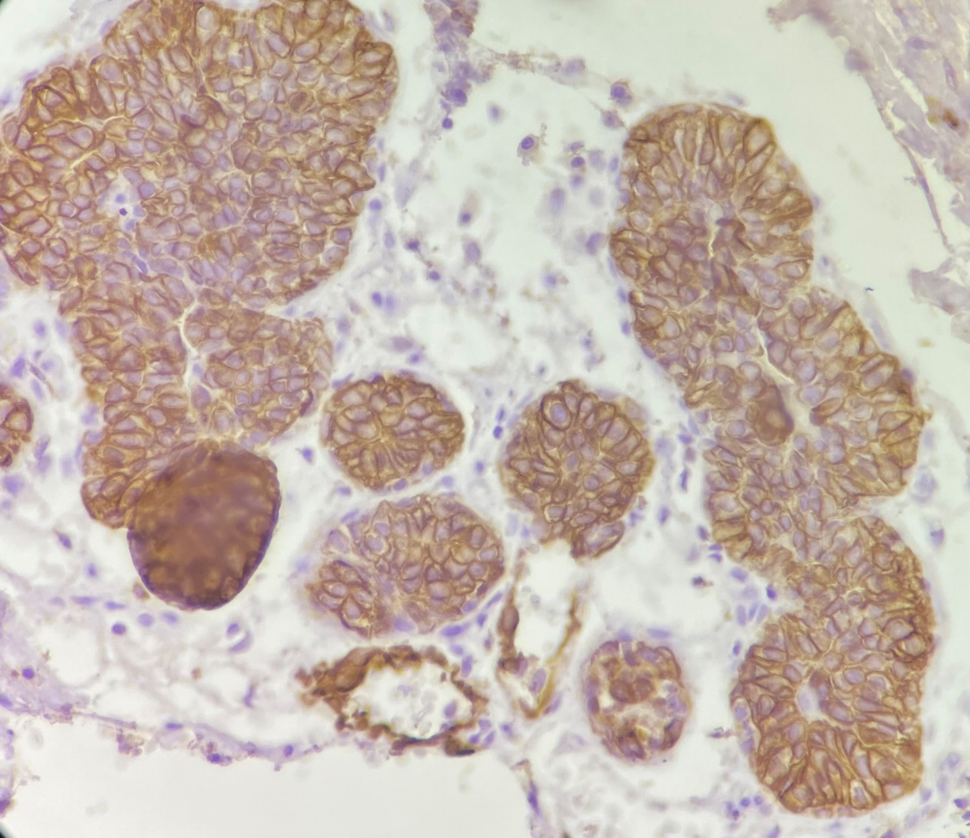
CK-14 positive

Slide 21
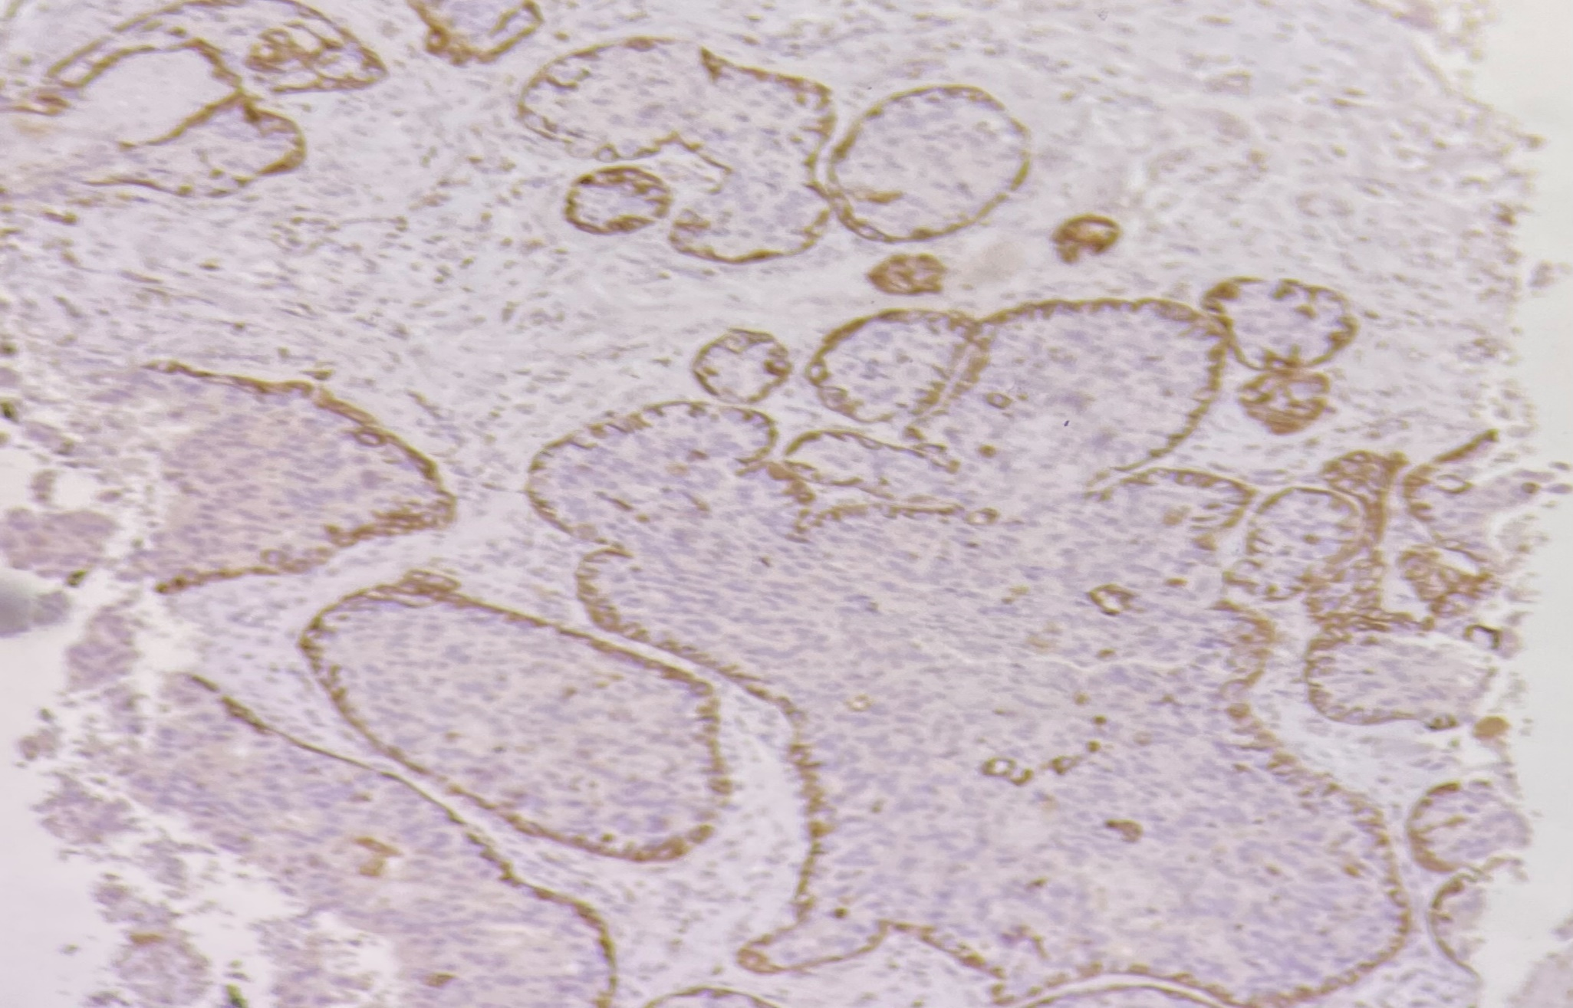
CK-14 negative

Slide 22
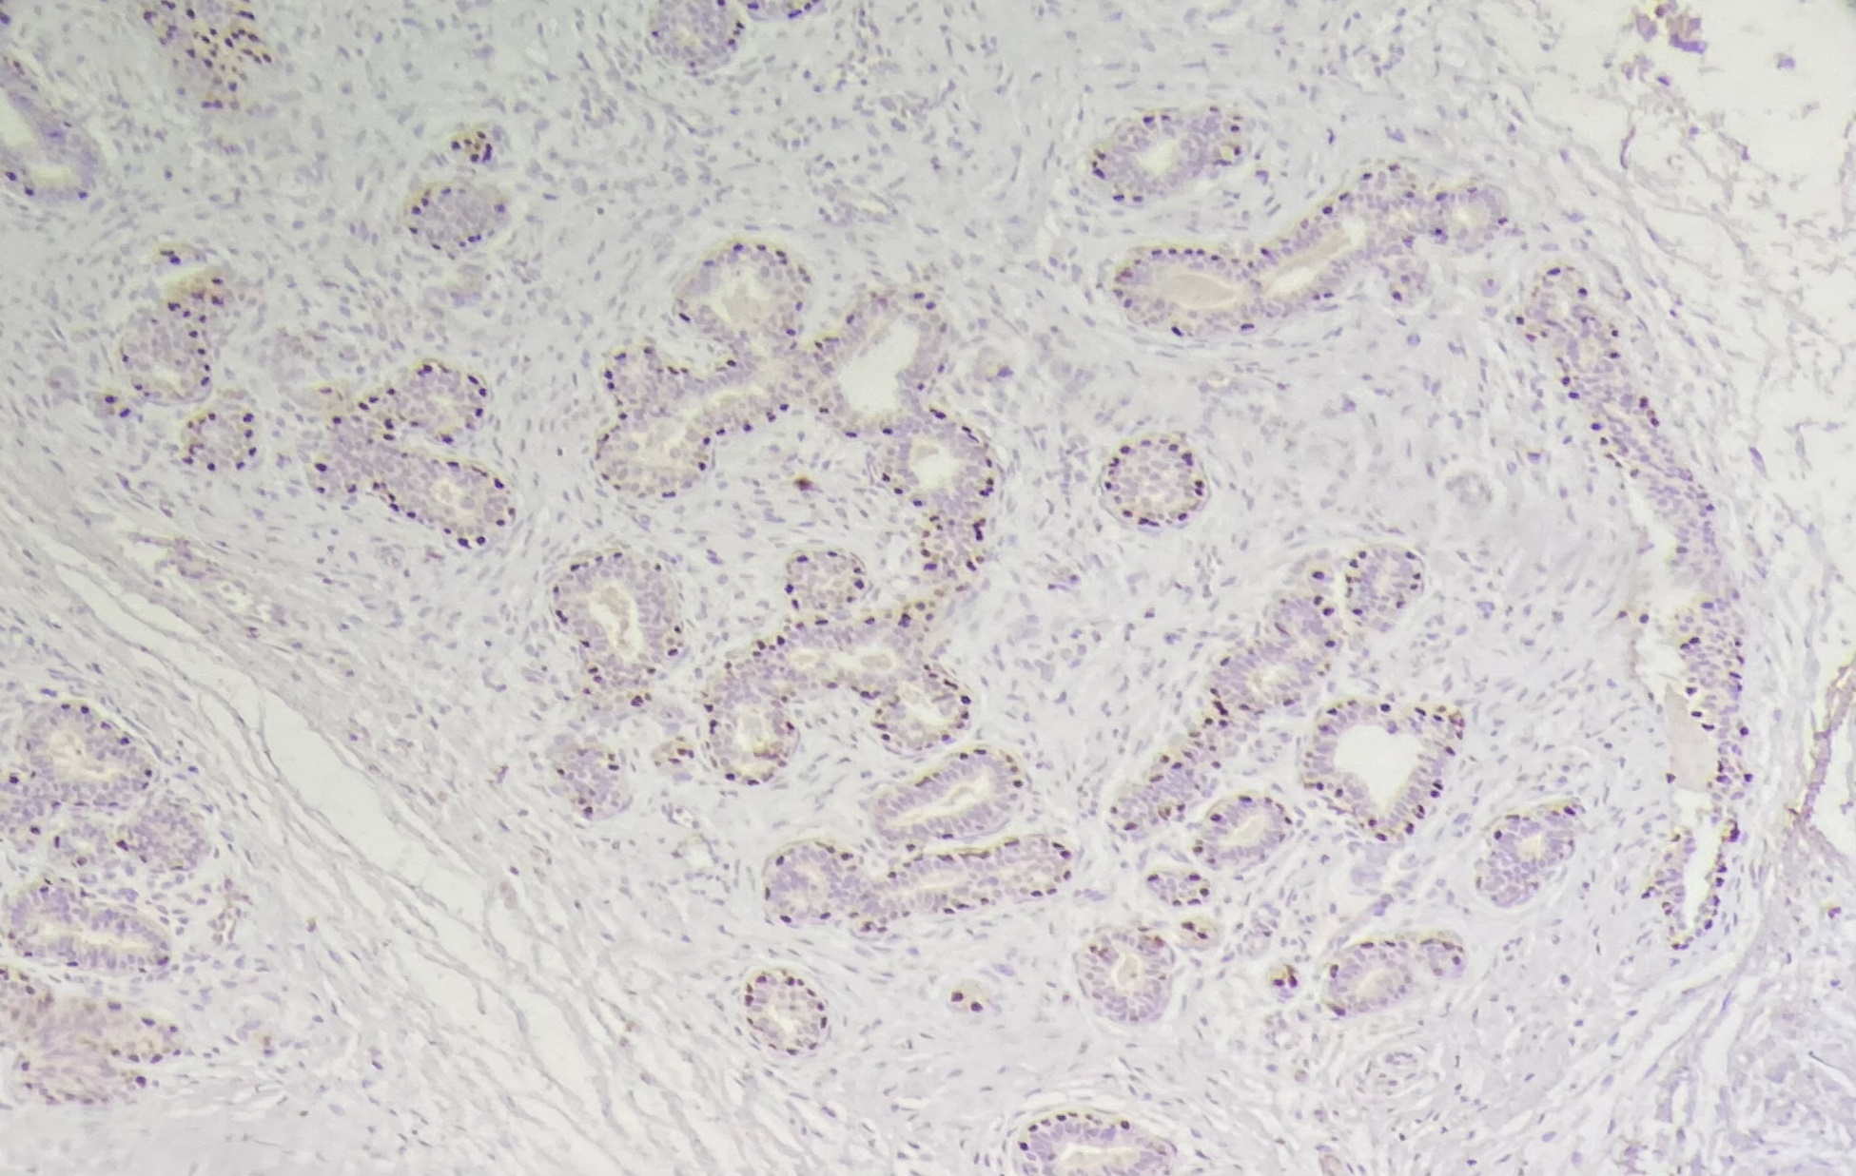
P63 positive

Slide 23
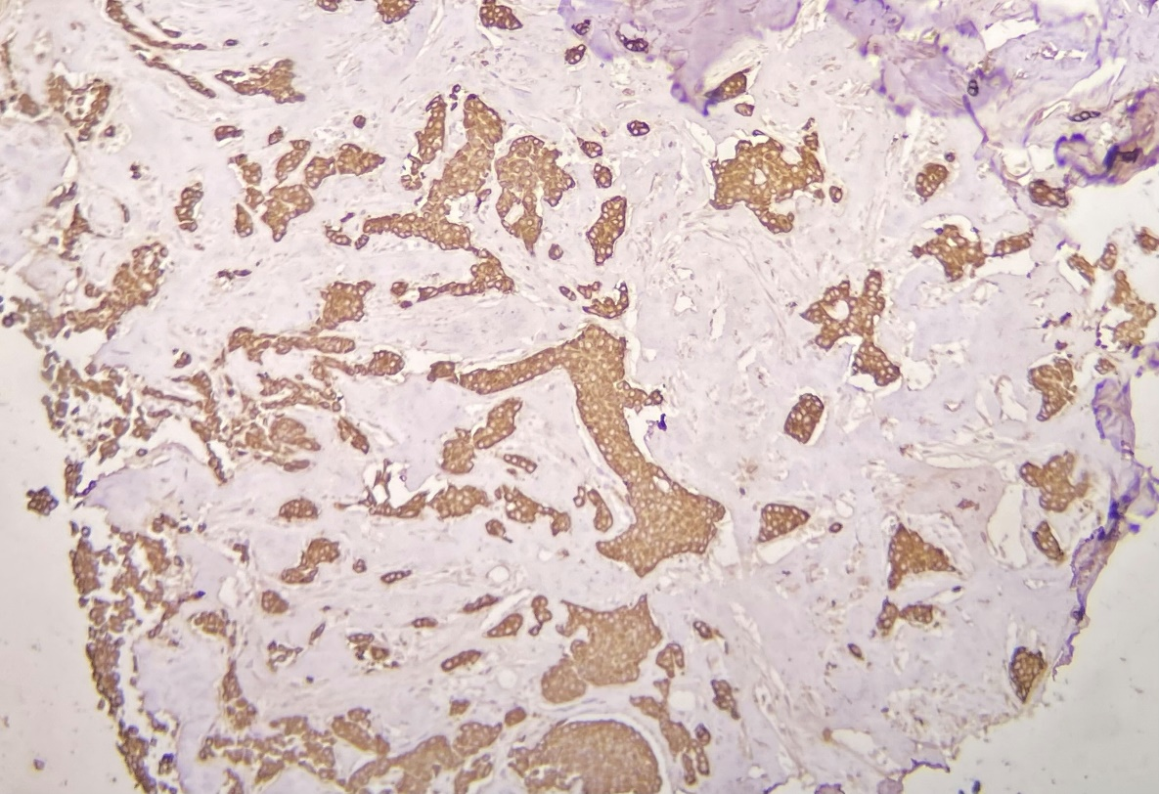
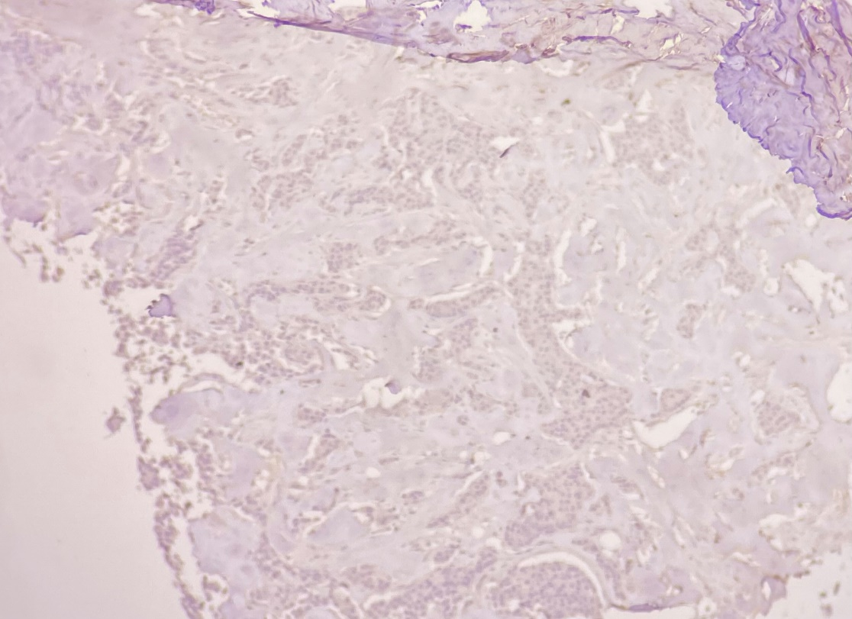
P63 negative
Pan-ck
P63

Slide 24
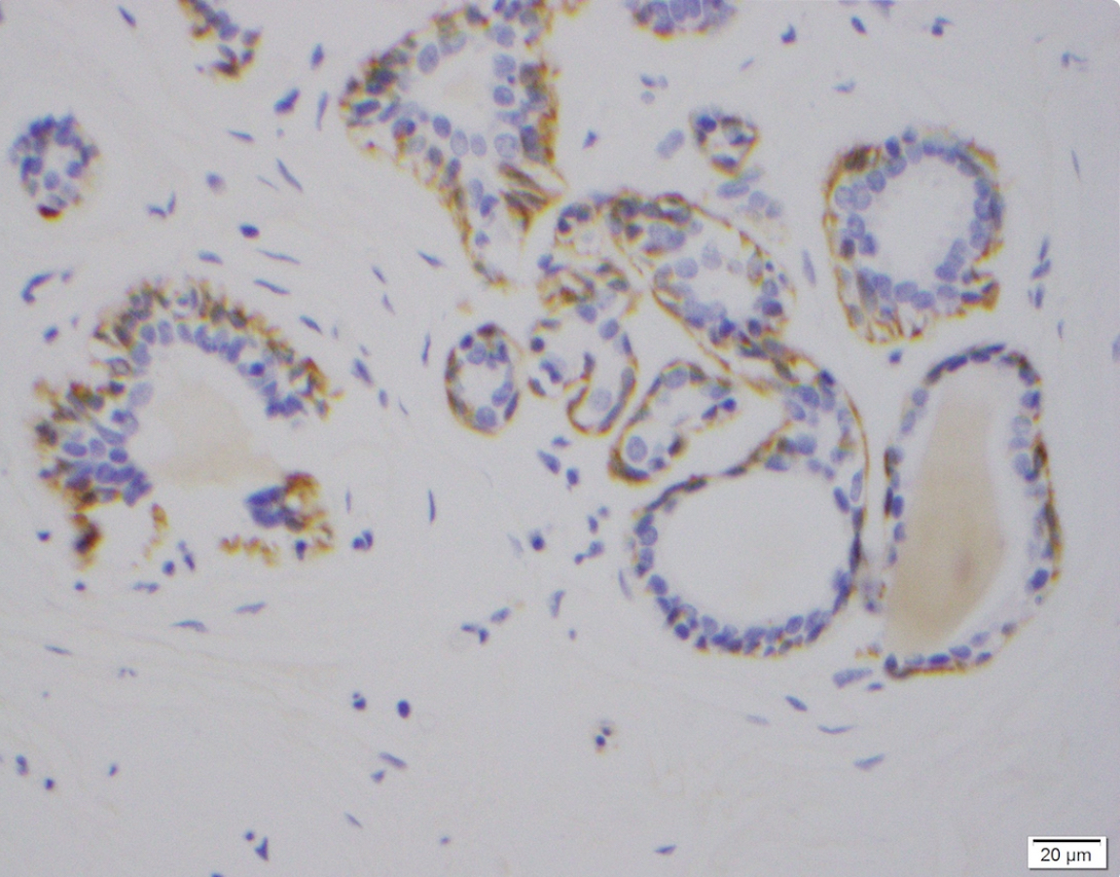
SMMH positive
Cytoplasmic staining in myoepithelial cells

Slide 25
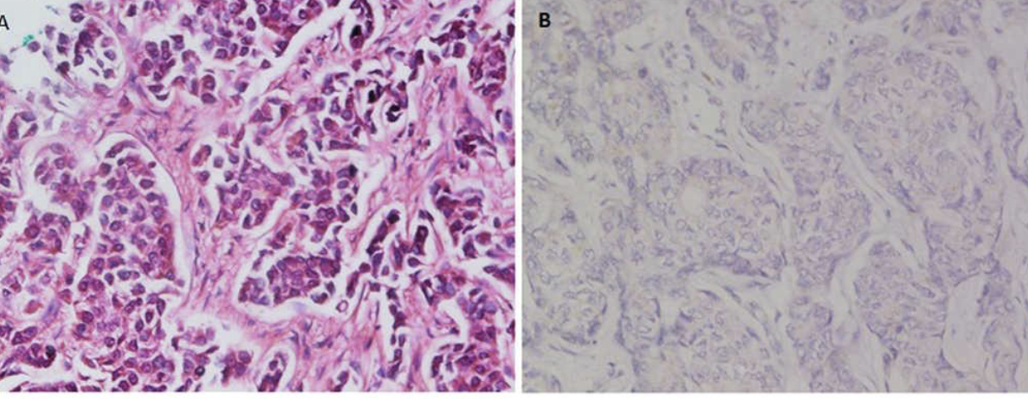
SMMH negative

Slide 26
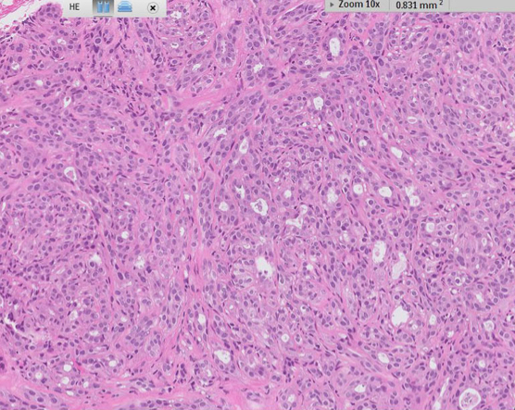
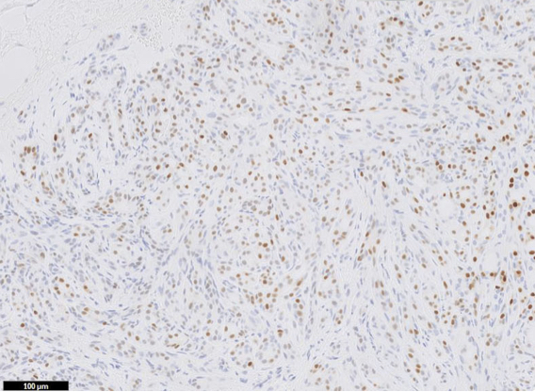
ER
heterogeneous

Slide 27
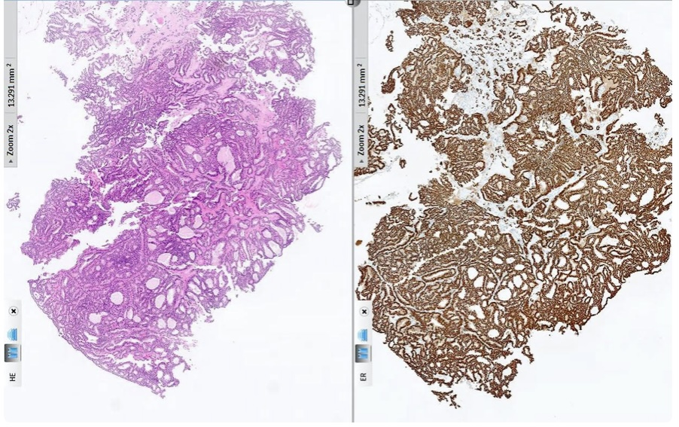
ER
diffusely

Slide 28
THE END

